Slide 1
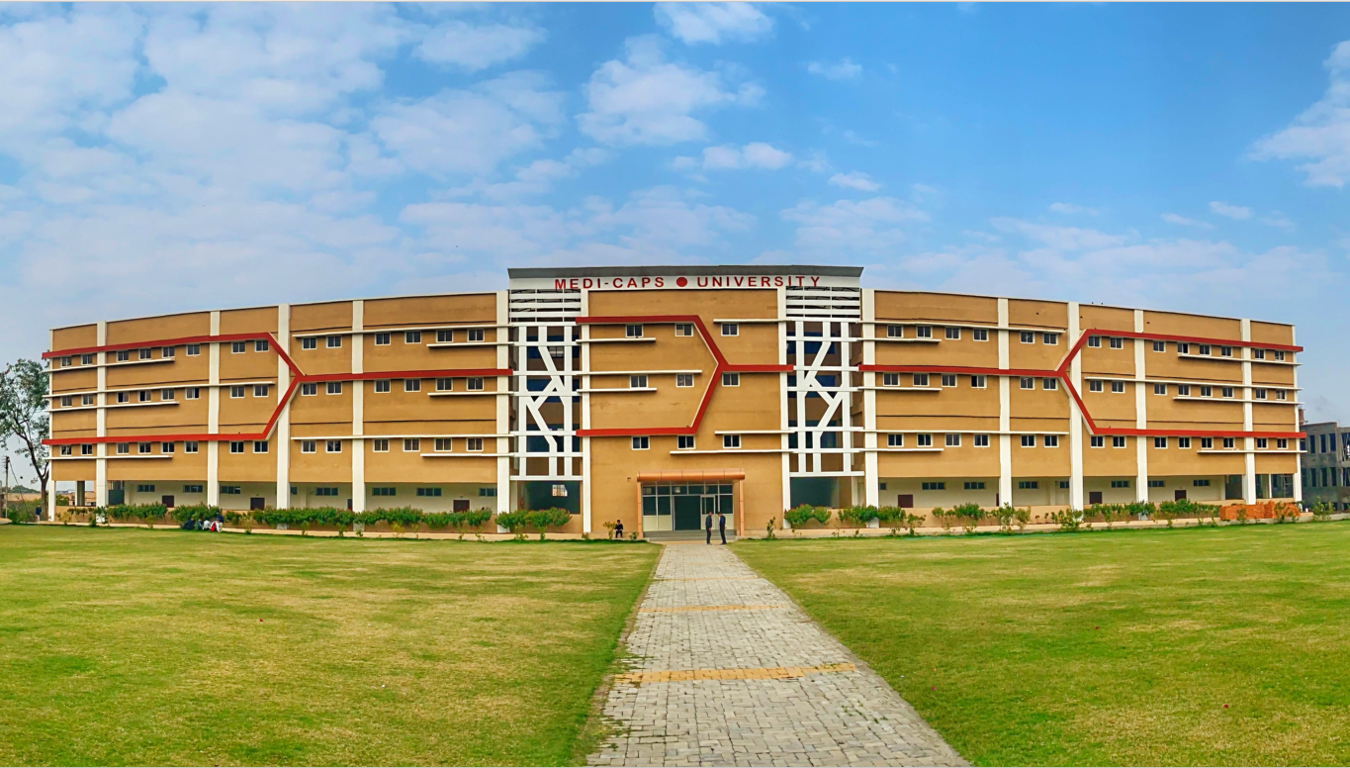

Object Oriented Programming (CS3C023)
Mini Project
Covid -19 Self Care And Vaccine Tracker

Slide 2
Covid -19 Self Care And Vaccine Tracker
Medi-Caps University
Mini Project
Session: Aug 2021 – Dec 2021
Batch – 2020-2024
Submitted by: Guided By:
EN20CS301351 RISHI NIGAM Mr. Arpit Deo Sir
EN20CS301339 RASHMI KOLHE Assistant professor
EN20CS301317 PRIYANKA SHARMA

Slide 3
Acknowledgement
We would like to express our special thanks to our Professor Mr.Arpit Deo Sir who gave us the golden opportunity to do this wonderful project on the topic “Covid -19 Self Care And Vaccine Tracker” which also helped us in doing a lot of research and we come to know about so many new things.

Slide 4
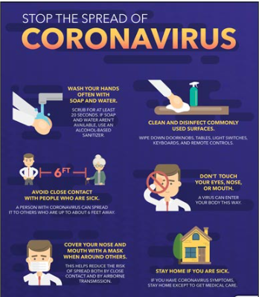
Contents
Problem Statement
Introduction
System Requirements
Need of Application
Header Files Used
Class and Function Used
Future Scope
Advantages and Drawbacks
Output Screen Shot
EN20CS301351 RISHI NIGAM , EN20CS301339 RASHMI KOLHE , EN20CS301317 PRIYANKA SHARMA

Slide 5

Problem Statement
In Society there is need of an application which keeps you updated regarding the status of active Covid-19 cases in your locality, as well as, in India. An Application which provides the various safety guidelines that you should follow to avoid infection and also to check whether you are symptomatic of Covid-19 or not.

Slide 6
INTRODUCTION
Covid -19 Self Care And Vaccine Tracker
This Mini Project in C++ Covid 19 Self Care And Vaccine Tracker is a console application using the C++ programing language. It is Compiled in Windows VS Code and DEV C++ with the GNU compiler.
In this Application, you can perform functions such as view current status of covid 19 in India, know government guidelines and help line Number , Covid Assessment and many more. File Handling has been Used many times in project so ,this project definitely guide you to understand project in better way.

Slide 7
System Requirements
Processor | Intel Core Processor Or Better Performance
Operating system | windows only
Memory | 1Gb ram or more
Files used | 4 Files ->> status, covid_status, Covid_test , Vaccinated _person Need to be saved in same Folder
Technology Used | C++
Compiler(In Windows only) | Dev C++, Visual Studio. (Not Online Compiler as They are lynx based)

Slide 8
Need For This Application
This Application will let you avail the following benefits:
This application keeps you updated regarding the status of active Covid-19 cases in your locality, as well as, in India.
Assess whether you are residing in a hotspot area, where virus occurrence is high.
Learn about the various safety guidelines that you should follow to avoid infection.
Self-assessment to determine whether you are symptomatic of Covid-19.

Slide 9
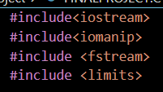
Header Files Used In the Project
#include<iostream>
iostream provides basic input and output services
for C++ programs.
2. #include<iomanip>
The iomanip is a library in C++ which helps us in manipulating the output of any C++
program.
3. #include <fstream>
To read and write from a file we are using the standard C++ library called fstream.
4. #include <limits>
This header defines constants with the limits of fundamental integral types for the
specific system and compiler implementation used.

Slide 10
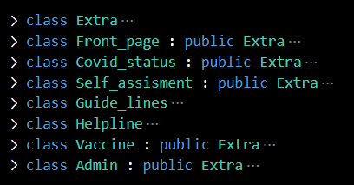
Class Created in Project
Extra (Parent Class)
Front Page (Inherited from Extra class)
Covid_status (Inherited from Extra class)
Self_assisment(Inherited from Extra class)
Guide_lines
Helpline
Vaccine (Inherited from Extra class)
Admin (Inherited from Extra class)

Slide 11
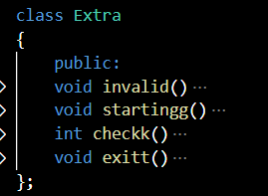
List of Functions Created(Inside Classes) and Used within project
void invalid()
This function will check any Input taken is in correct form or not.
void starting()
This Function will print heading of the every page in output.
void check()
When this function is used it will check the input data type is integer or not.
void exit()
This function will exit the program.

Slide 12
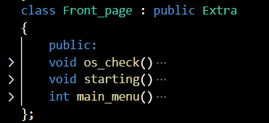
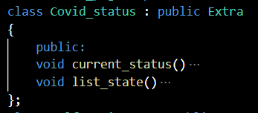
List of Functions Created(Inside Classes) and Used within project
void starting()
This function is used to print Front Page of the Project.
void main_menu()
This function will print the main menu for the user.
void os_check()
This function will check that operating system is windows or not.
void current_status()
This function will let user to know current covid status.
void list_state()
This Function will print the State wise Covid-19 Current Status.

Slide 13
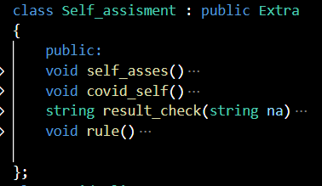
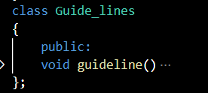
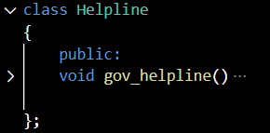
List of Functions Created(Inside Classes) and Used within project
void self_asses() and string result_check(string na)
Combination of these two function will take covid assessment and
generate result.
void covid_self()
This function will print the menu for self assessment.
void guideline()and void gov_helpline()
this function is used to print recent government guide lines and
helpline number of covid-19 respectively.

Slide 14
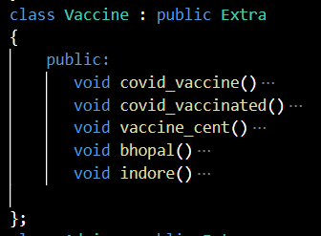
List of Functions Created(Inside Classes) and
Used within project
void covid_vaccine()
This function will print the menu for vaccine realated issues.
void covid_vaccinated()
This function will take details of user if he or she is vaccinated.
void vaccine_cent()
This function will give you choice that user want to know vaccine
centers from which city.(Indore/Bhopal).
void Bhopal() & void indore ()
This function is used to print vaccination centers available in Bhopal
and Indore respectively .

Slide 15
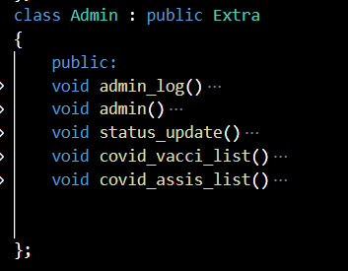
List of Functions Created(Inside Classes) and Used within project
void covid_vacci_list(), void_assis_list() --- These function will print list of vaccinated person and list of person who have performed covid assessment.
void admin_log() ---- This function will take user to Administrator login page and if password entered correctly Admin() will run.
void status_update() --- This Fuction will update number of Active , Recovered and Decreased cases.

Slide 16
Extra Functions Used From Header Files
setw() - The setw C++ function helps to set the field width used for output operations.
Cin.sync() - Typing “cin.sync()” after the “cin” statement discards all that is left in the buffer.
cin.ignore(numeric_limits::max(),’\n’) - “cin.ignore(numeric_limits::max(),’\n’);” after the “cin” statement
discards everything in the input stream including the newline.
cin.clear - The cin.clear() clears the error flag on cin (so that future I/O operations will work correctly)
System(“cls”) - CLS (for clear screen) is a command used operating systems to clear the screen or console
window of commands and any output generated by them.
System(pause ) - ses of system() in Windows OS are, system(“pause”) which is used to execute pause command and make the screen/terminal wait for a key press.

Slide 17
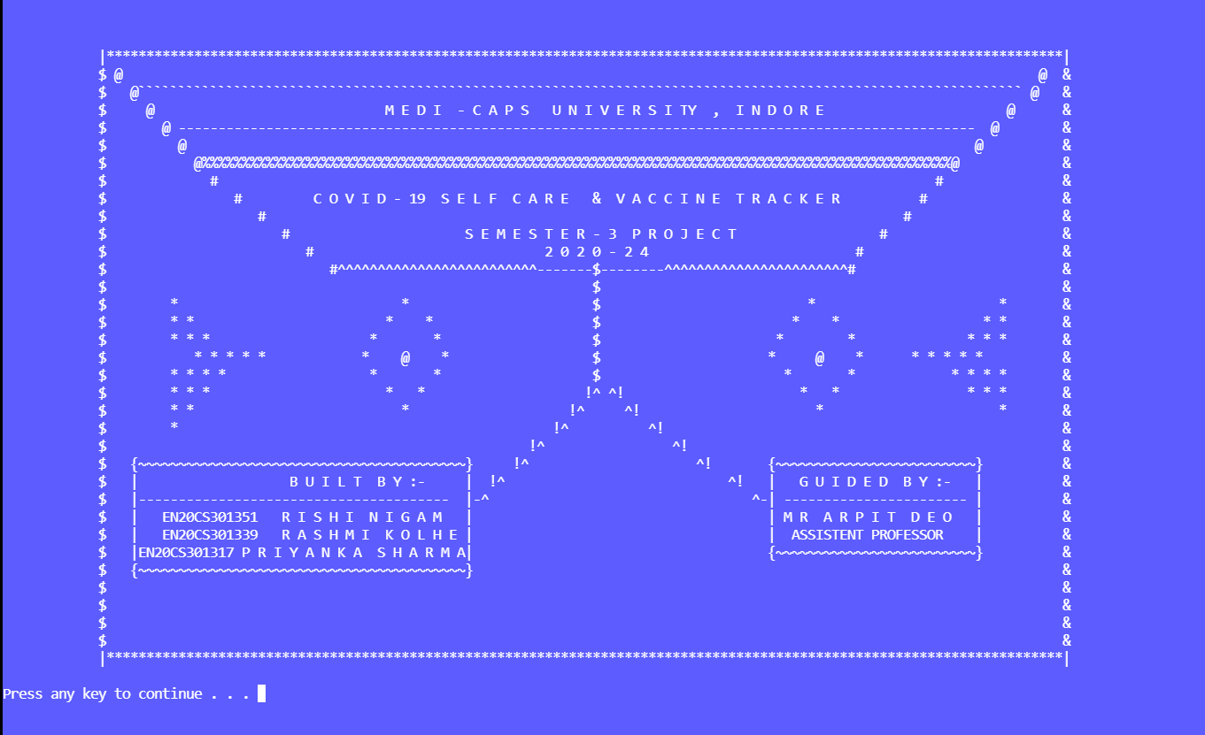
Output
Front Page

Slide 18
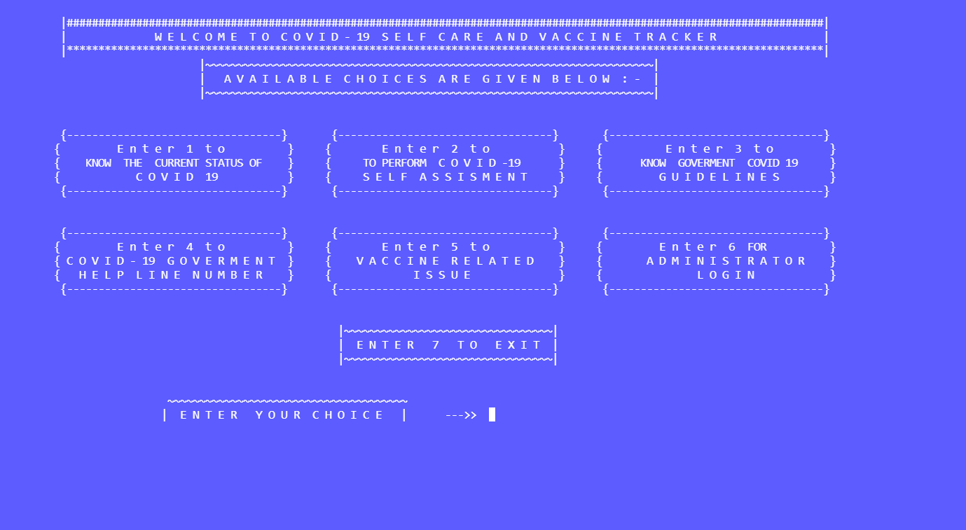
Main Menu

Slide 19
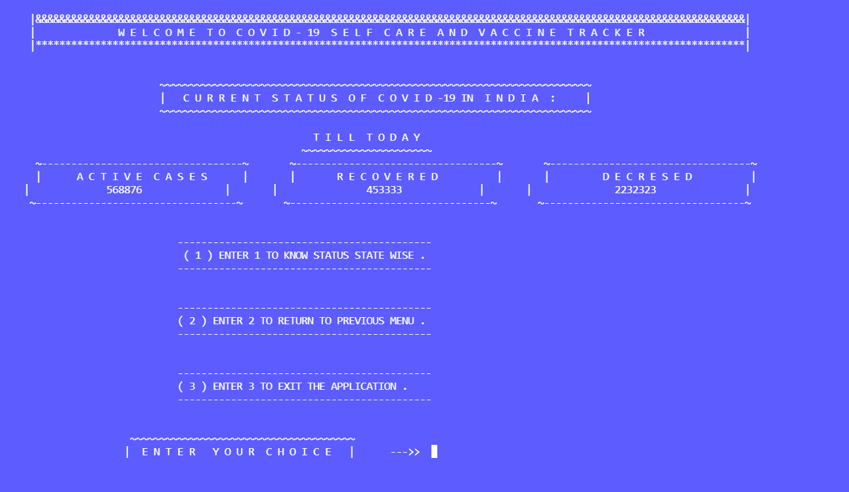
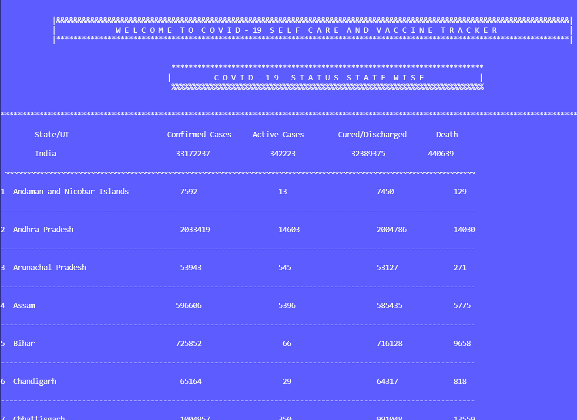

Slide 20
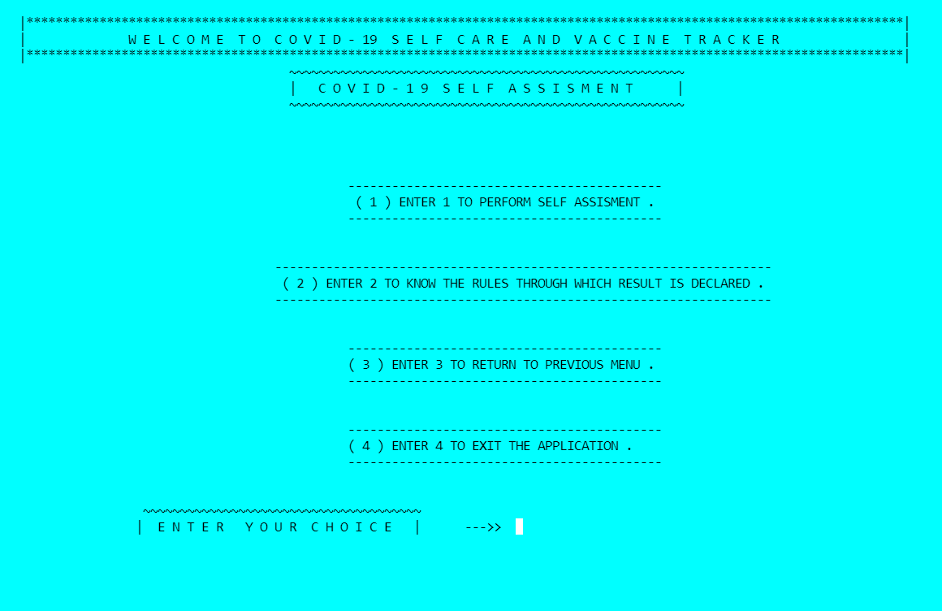

Slide 21
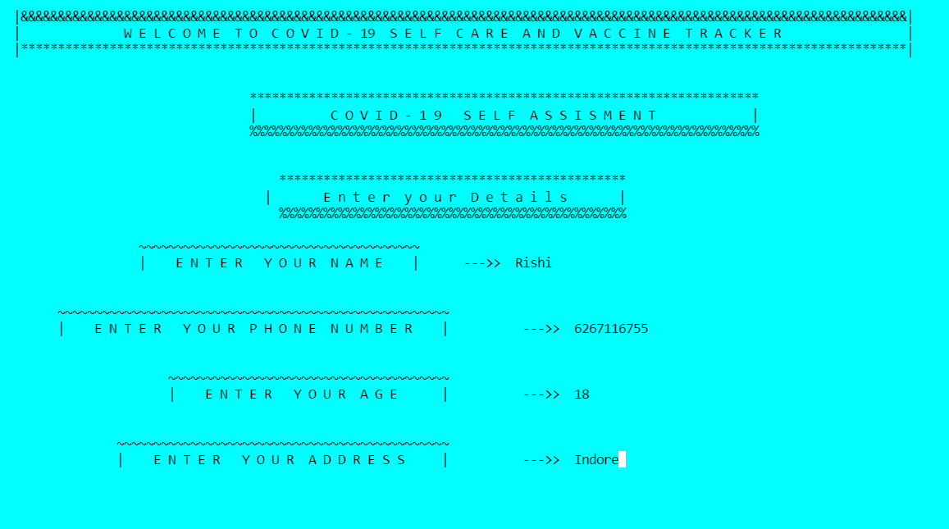

Slide 22
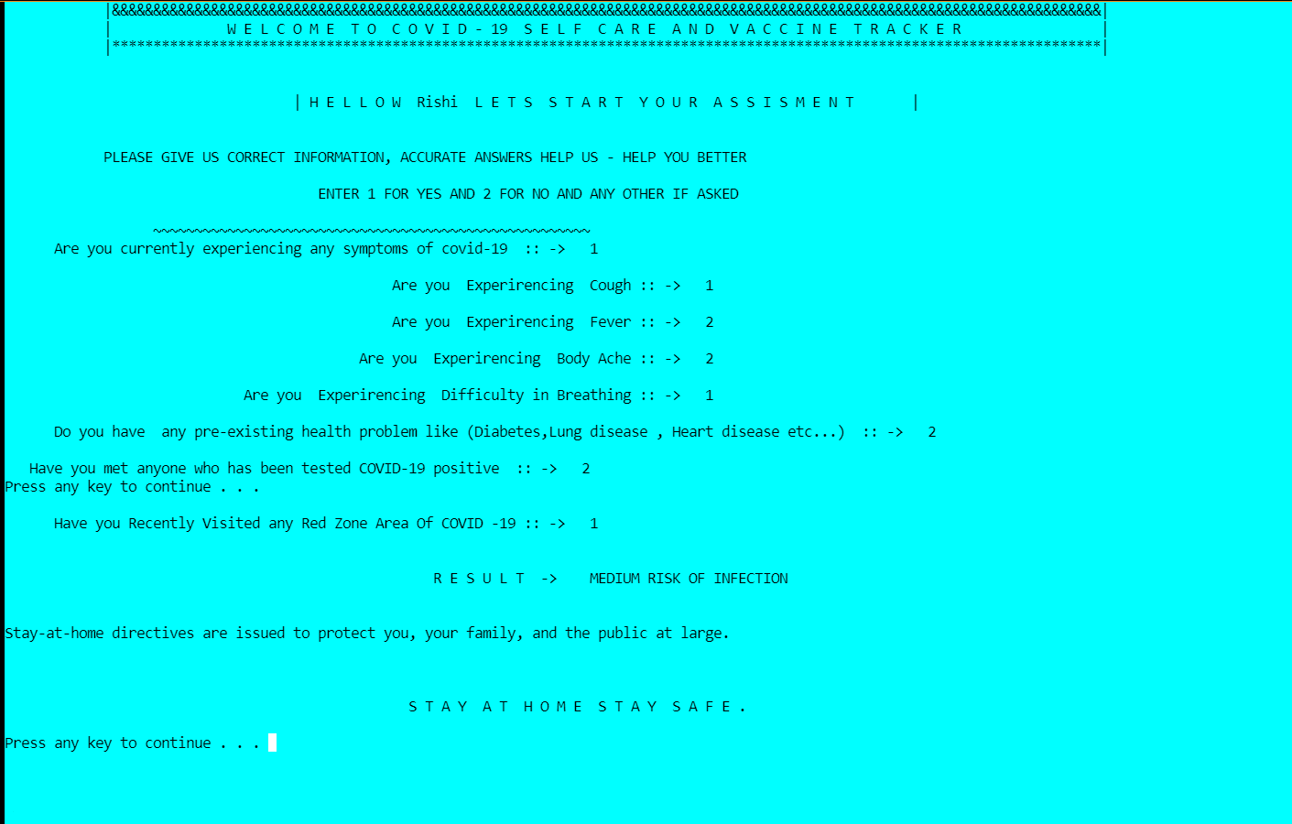

Slide 23
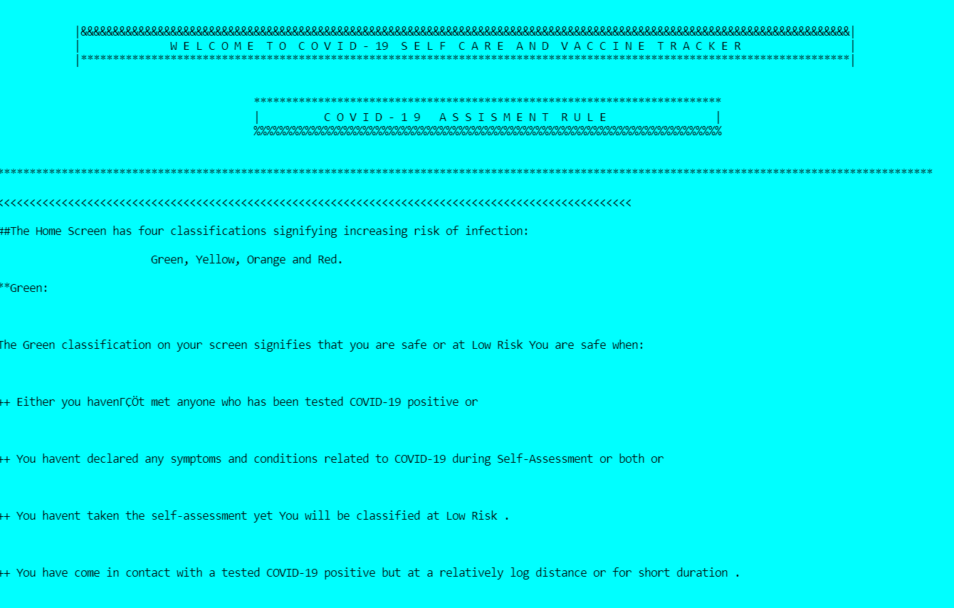

Slide 24
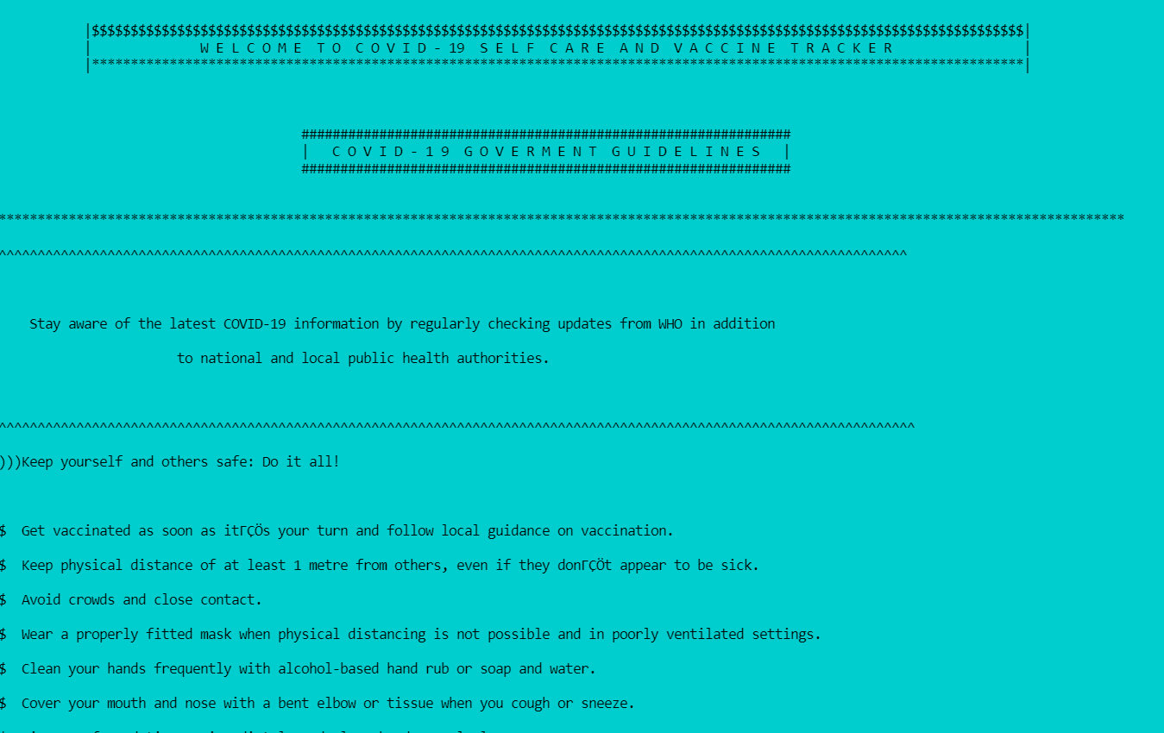

Slide 25
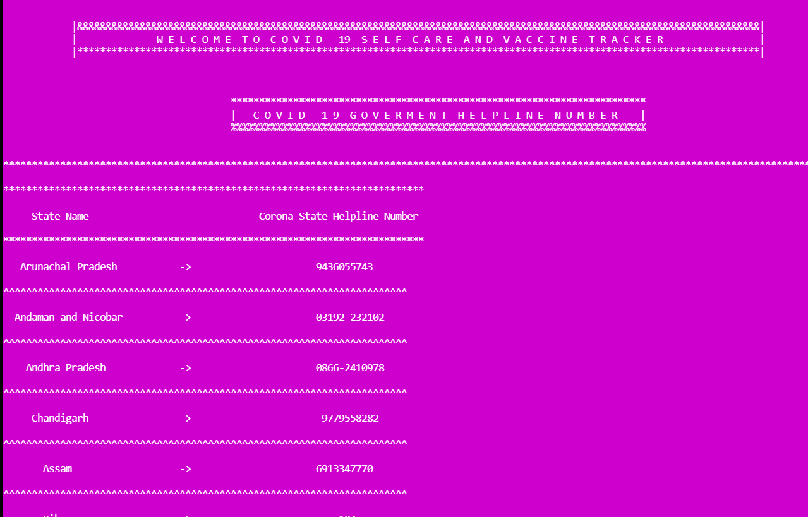

Slide 26
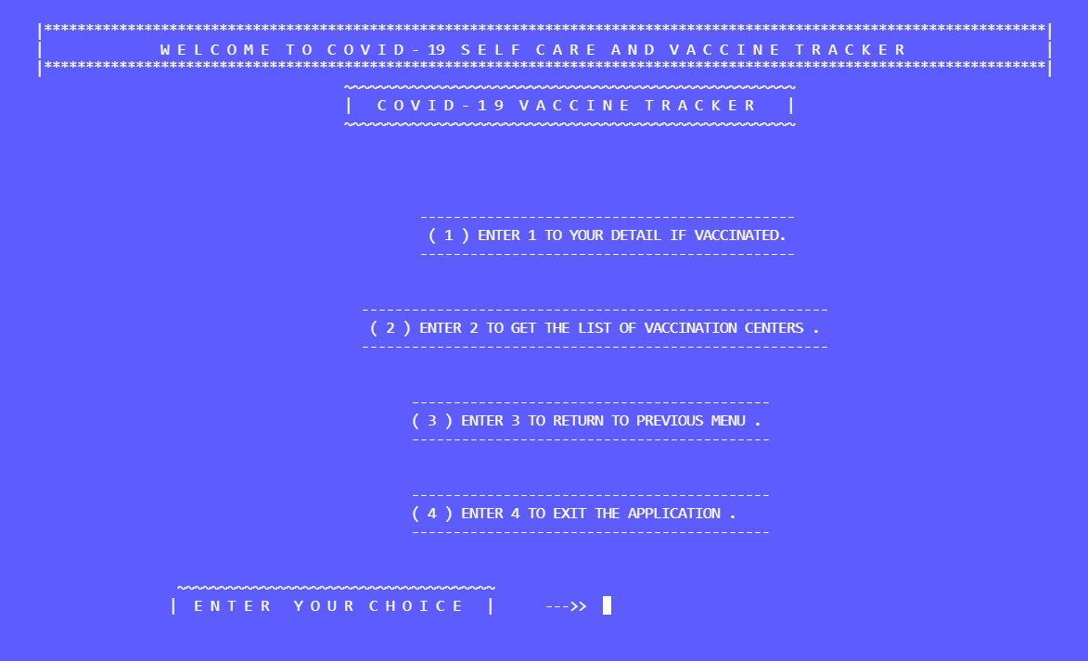

Slide 27
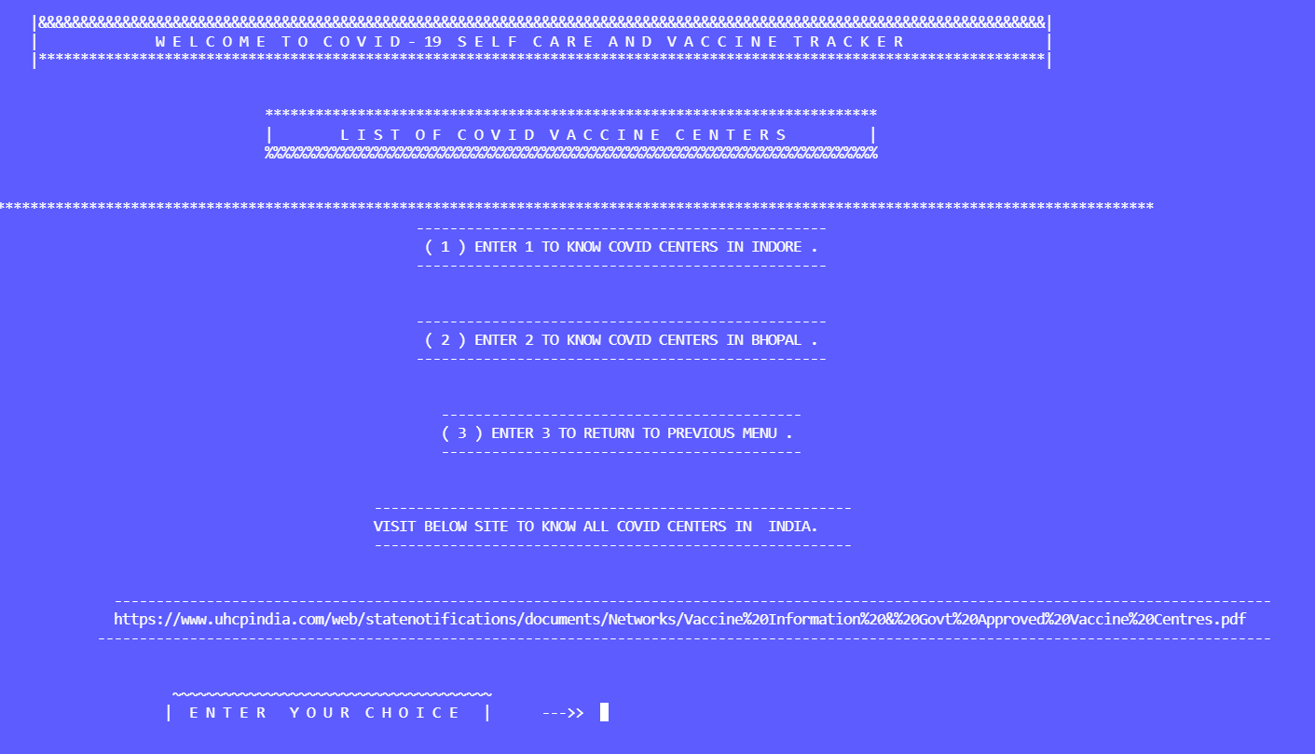

Slide 28
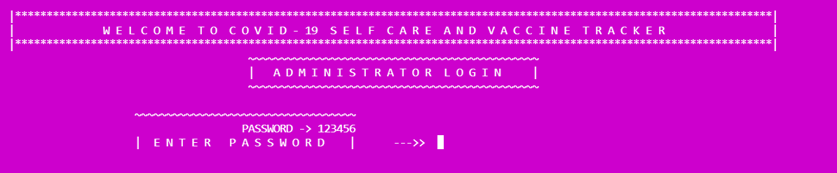
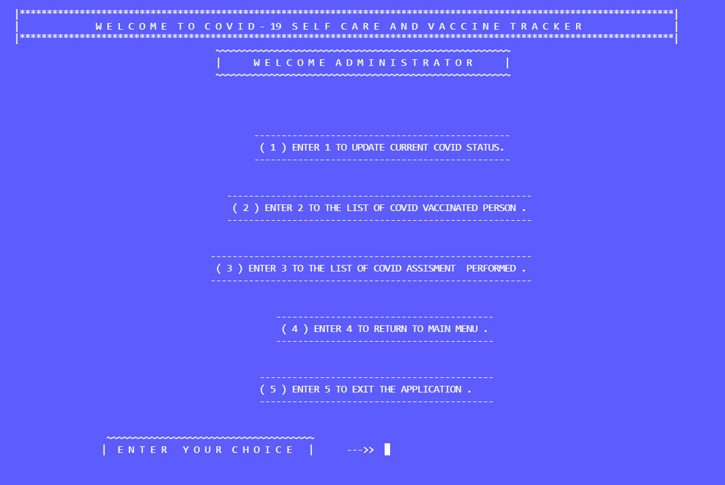

Slide 29
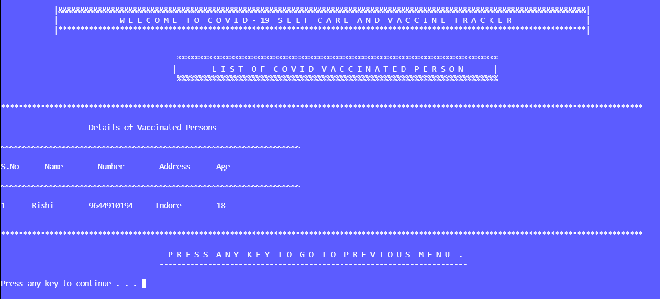

Slide 30
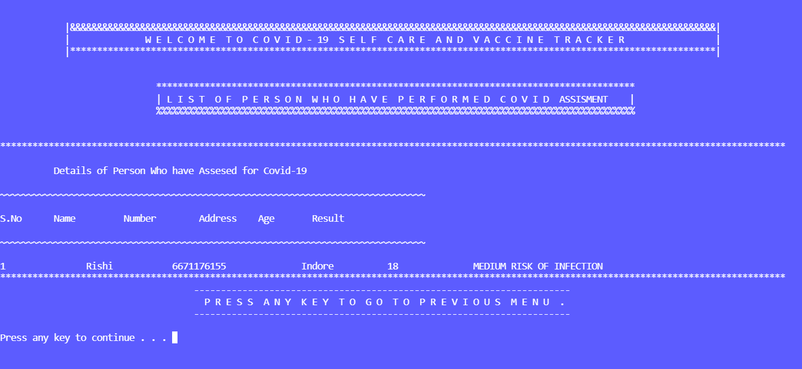

Slide 31
Future Scope
This application can be easily implemented under various situations. we can add new features as and when we require. Reusability is possible when we require in this application.
This software is extendable in ways the developer may not expect as the code is easily understandable.
Features like GPS system , More Security etc.. Can be added in future which will make Application more efficient.

Slide 32
ADVANTAGES
With the help of self-assessment we will get information whether we are affected from covid-19 or not.
Learn about various safety guidelines that we should followed to avoid infection .
The user can also find the helpline no. for each state in India.
We also resolved the the vaccine related issues.

Slide 33
DRAW BACKS
We will not able to edit the data which we inserted in it.
We cannot delete any data from the list containing vaccinated and covid test.
It does not have the facility of location and Bluetooth.
In this we get only the information about covid centres in Indore and Bhopal.

Slide 34


